Slide 1

MARKETING & RETAIL ANALYTICS
Project Business Report – DSBA
Submitted By : Maheep Singh
Batch : PGP-DSBA (PGPDSBA.O.AUG24.A)

Slide 2

CONTENT
1. PART A – Automobile Sales Problem
Business Context & Problem Statement
Data Summary
Exploratory Data Analysis
Customer Segmentation using RFM analysis
Inferences & Business Recommendations
2. PART B – Grocery Retail Problem
Business Context & Problem Statement
Data Summary
Exploratory Data Analysis
Market Basket Analysis
Inferences & Business Recommendations

Slide 3

PART A – Automobile Sales Problem

Slide 4
BUSINESS CONTEXT & PROBLEM STATEMENT
Business Context
Automobile Parts Manufacturing Company – Sells products to a diverse range of customers for the past three years
Wish to leverage Analytics & uncover hidden patterns and trends in their customer transactions
Aims to better understand customer behavior, improve customer segmentation, and implement targeted marketing strategies
Carry out Customer Segmentation using RFM analysis
Ultimate goal is to enhance customer satisfaction, while, driving revenue growth by offering more personalized and efficient services.
Problem Statement / Objective
Identify underlying patterns in customer purchasing behavior
Segment customers based on their transactional data
Provide actionable insights to optimize the company's marketing efforts
Recommend personalized marketing strategies for each customer segment to maximize sales and customer retention

Slide 5
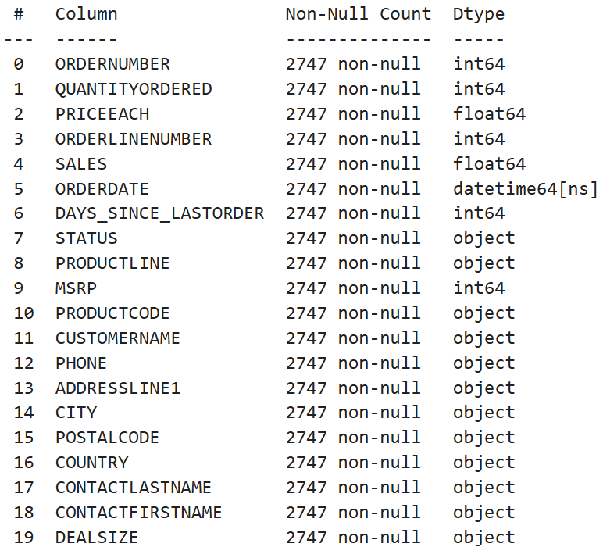
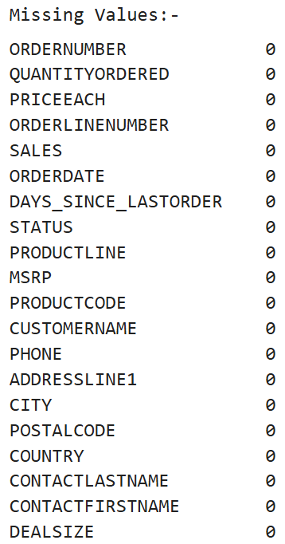
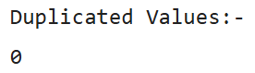
DATA SUMMARY (1/2)
Data Dictionary
Data Information
ORDERNUMBER : Order Number
CUSTOMERNAME : customer
QUANTITYORDERED : Quantity ordered
PHONE : Phone of the customer
PRICEEACH : Price of Each item
ADDRESSLINE1 : Address of customer
ORDERLINENUMBER : order line
CITY : City of customer
SALES : Sales amount
POSTALCODE : Postal Code of customer
ORDERDATE : Order Date
COUNTRY : Country customer
DAYS_SINCE_LASTORDER : Days_ Since_Lastorder
CONTACTLASTNAME : Contact person customer
STATUS : Status of order like Shipped or not
CONTACTFIRSTNAME : Contact person customer
PRODUCTLINE : Product line – CATEGORY
DEALSIZE : Size of the deal based on Quantity and Item Price
MSRP : Manufacturer's Suggested Retail Price
PRODUCTCODE : Code of Product

Slide 6
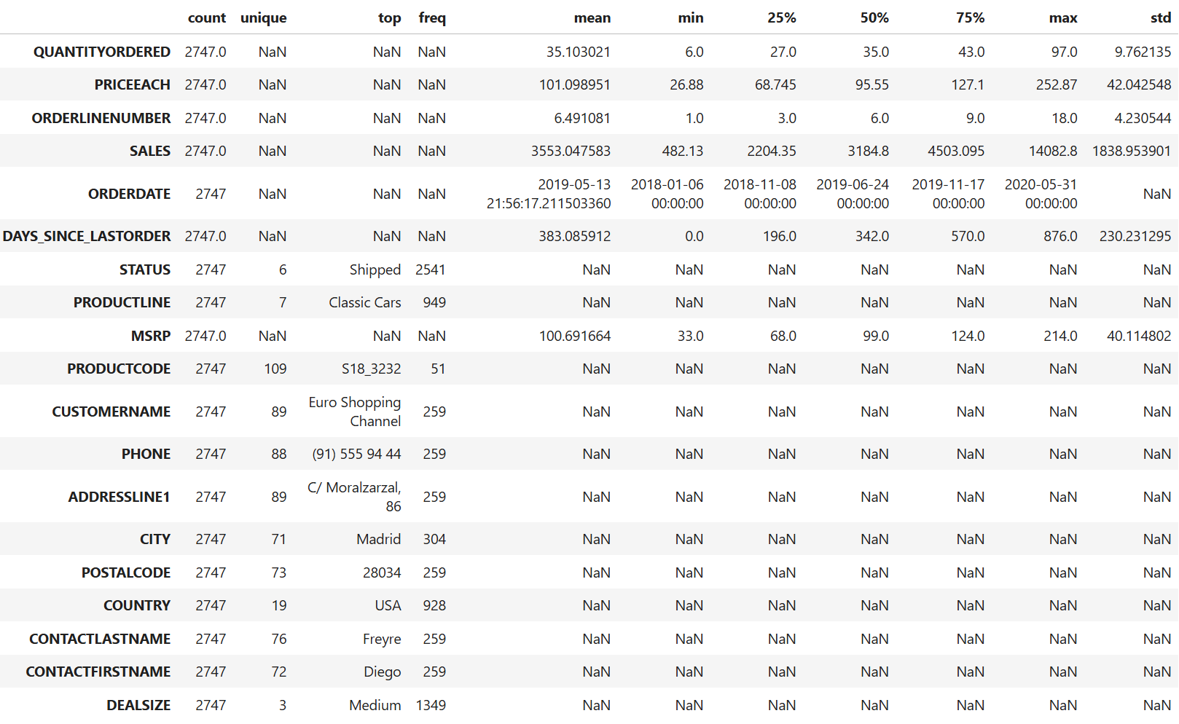
DATA SUMMARY (2/2)
Data Description
Data Inference
Data: Past 3 years.
Dataset: 20 columns and 2747 rows
Missing values and Duplicate values: None
No abnormalities detected in the data that required pre-processing
Mean of No. of items ordered = 35 | Standard Deviation = 9.76 | Range covering 68% values = 25-45
Mean of Price of each item = 101.9 | Standard Deviation = 42.04 | Range covering 68% values = 60-144
Mean of Sales amount per order = 3553.05 |Standard Deviation = 1838.95 | Range covering 68% values = 1714-5392
Mean of Days since the last order = 383.09 |Standard Deviation = 230.23 | Range covering 68% values = 153-613
Mean of Manufacturer's Suggested Retail Price per order = 100.69 |Standard Deviation = 40.11 | Range covering 68% values = 61-141
Assumptions: -
Each row in the data represents a unique transaction made by a customer
‘DAYS_SINCE_LAST_ORDER' is ignored and recomputed as '[Max(ORDERDATE)- ORDERDATE]'
The recommendations provided are based on the insights gained from the analysis of the transaction data.

Slide 7
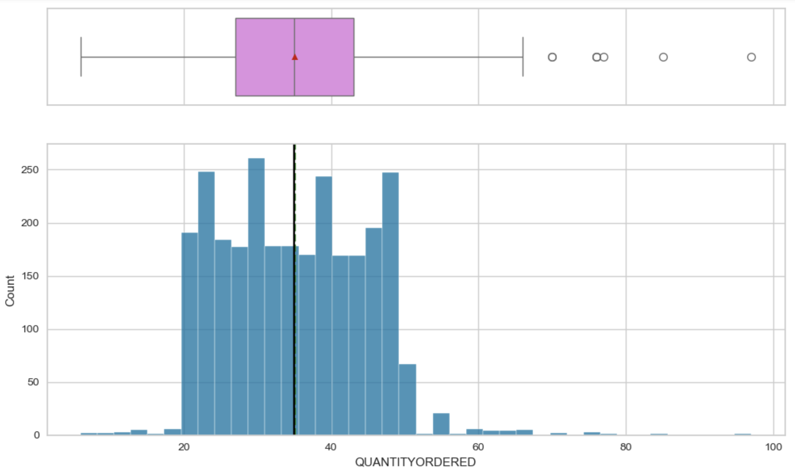
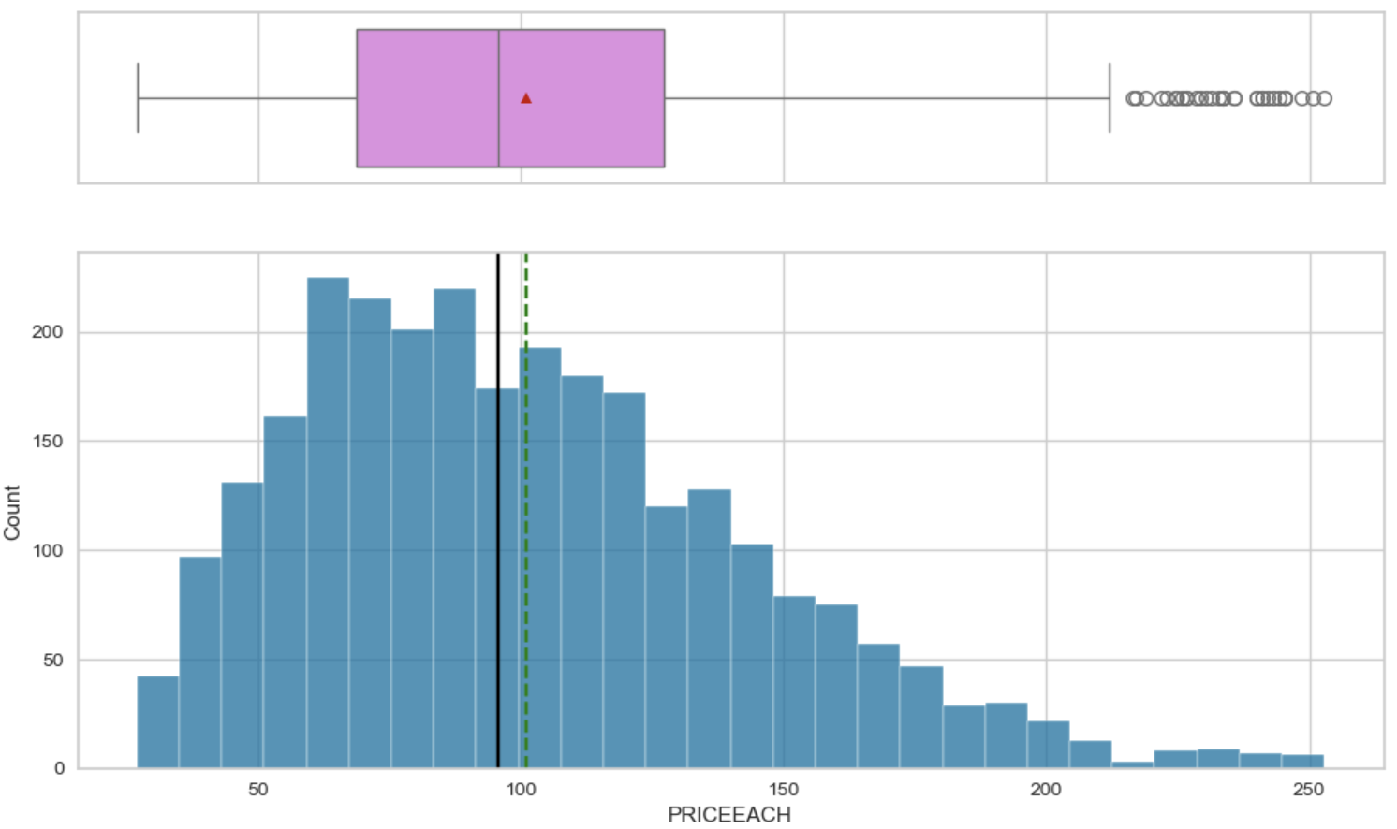
EXPLORATORY DATA ANALYSIS (1/13)
Univariate Analysis
Quantity Ordered:-
There is a large variation
Distribution seems to be symmetric with similar mean & median
Seems to be multi-modal distribution having multiple peaks.
Few outliers observed, but we would keep the data as-is to avoid any loss of information.
Price of Each Item:-
There is a large variation
Distribution seems to be slightly right-skewed
Seems to be multi-modal distribution having multiple peaks
Lot of outliers observed, but we would keep the data as-is to avoid any loss of information

Slide 8
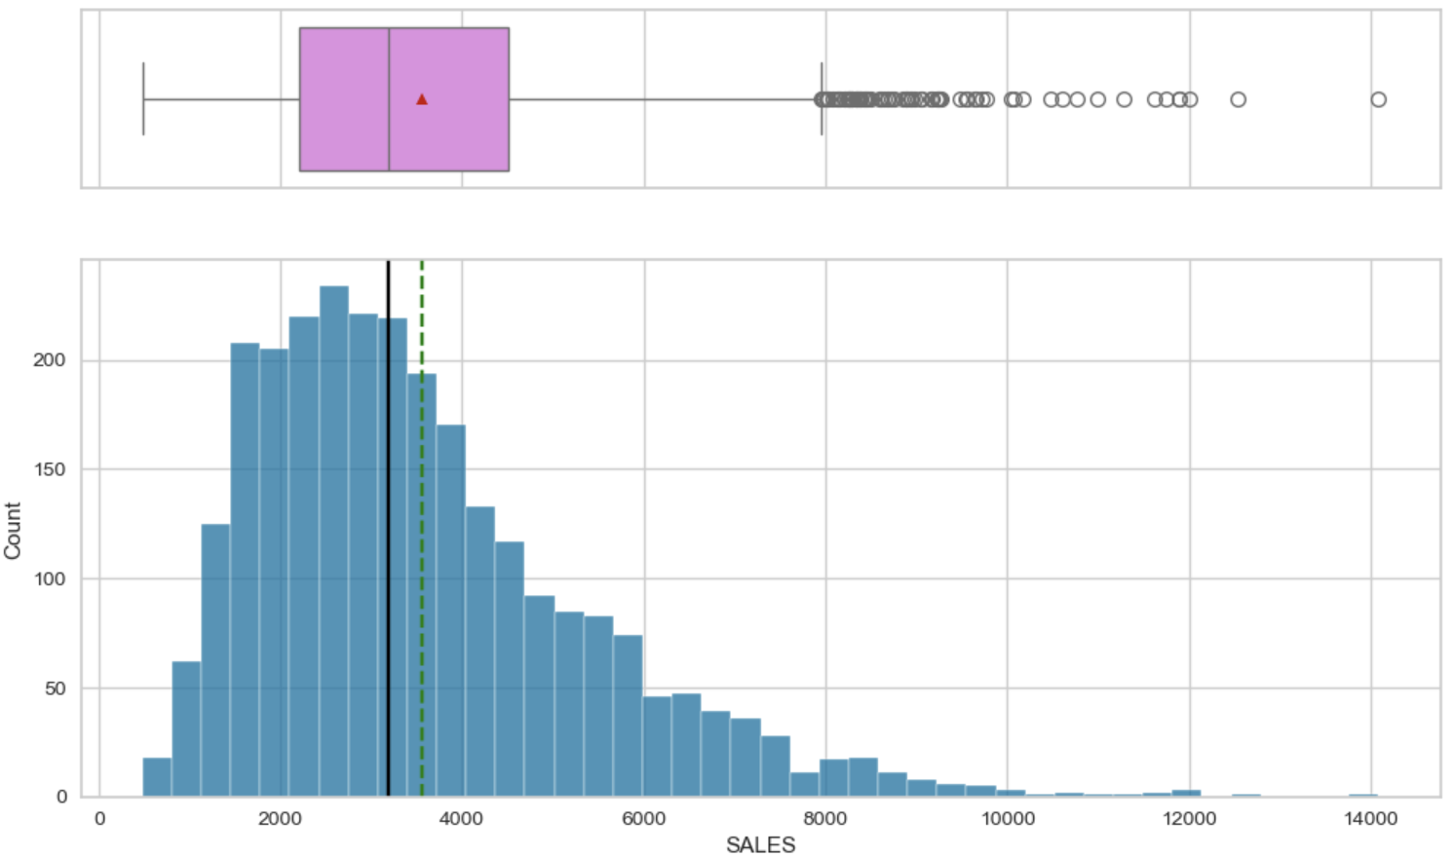
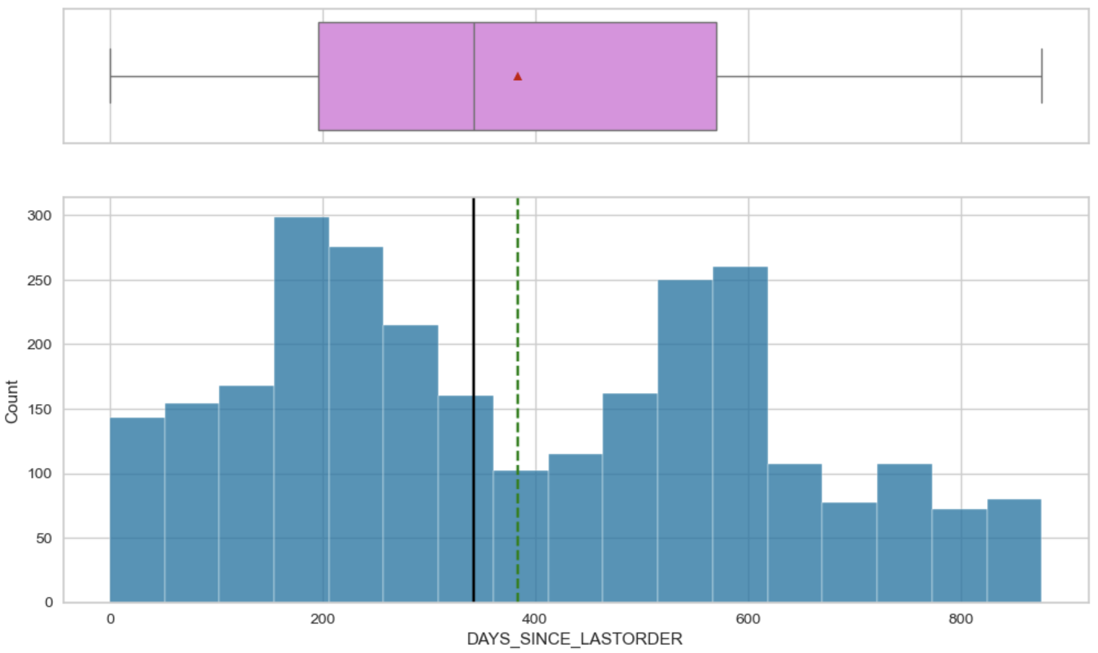
EXPLORATORY DATA ANALYSIS (2/13)
Univariate Analysis
Sales:-
There is a large variation
Distribution seems to be right-skewed
Seems to be unimodal distribution
Lot of outliers observed, but we would keep the data as-is to avoid any loss of information.
Days Since Last Order:-
There is a large variation
Distribution seems to be slightly right-skewed
Seems to be Bi-modal distribution having 2 peaks
No outliers observed

Slide 9
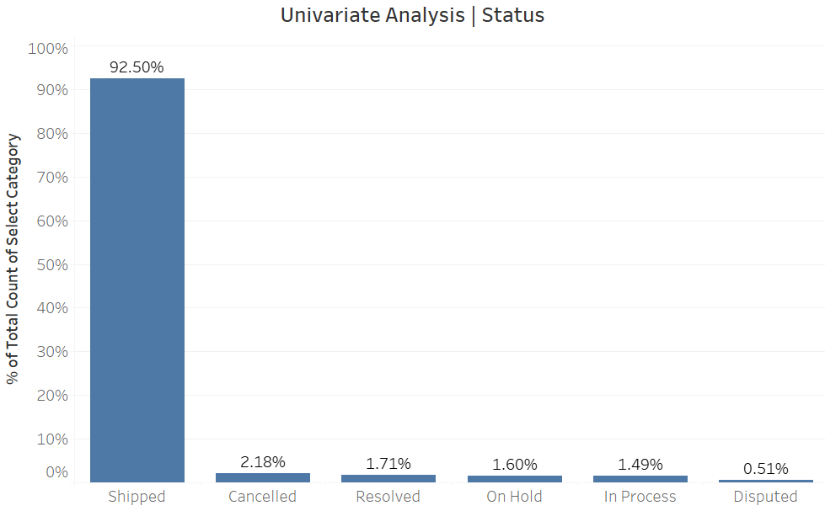
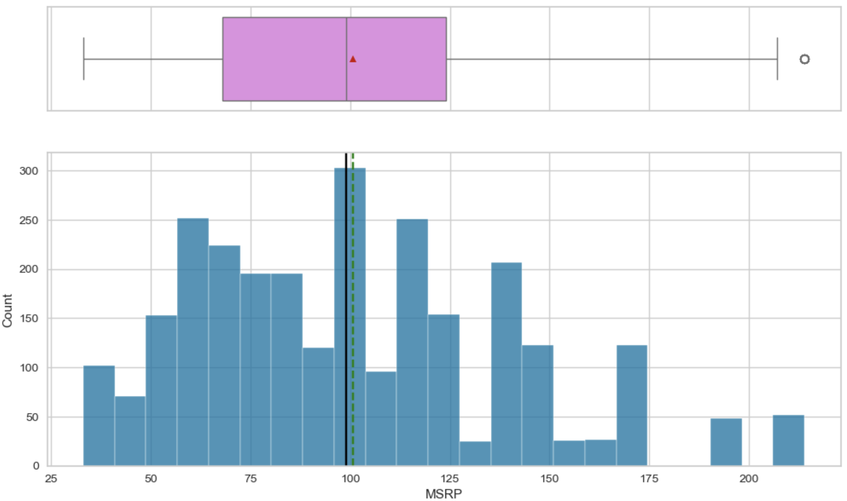
EXPLORATORY DATA ANALYSIS (3/13)
Univariate Analysis
Manufacturer's Suggested Retail Price:-
There is a large variation
Distribution seems to be almost symmetrical
Seems to be unimodal distribution
No outliers observed
Status of the Order:-
Majority of the orders are in the Shipped state (~93%)
1-2% orders each are in Cancelled, Disputed In-progress, On-hold or Resolves State

Slide 10
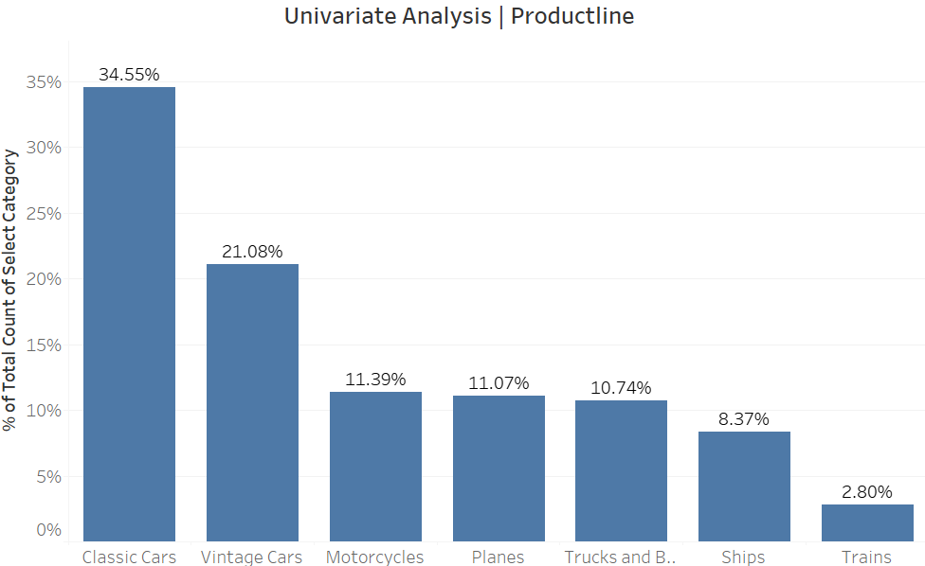
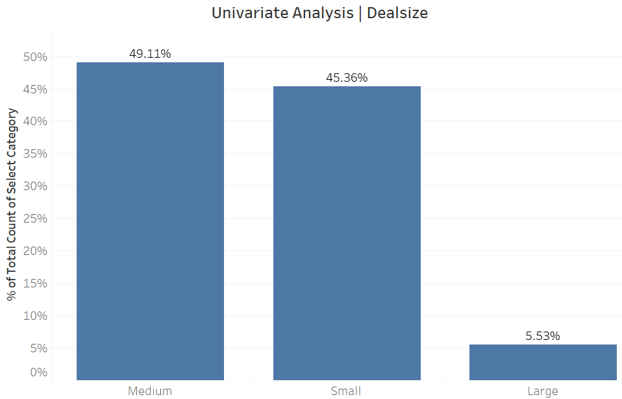
EXPLORATORY DATA ANALYSIS (4/13)
Univariate Analysis
Product Line (Category of Product):-
Majority of the products are Classic Car Parts (35%), followed by Vintage Car Parts (21%)
Other categories constitute 8-12% each.
Deal Size:-
Majority of the deals are either Medium or Small (45-49%)
Only 5% constitute Large sized-deals

Slide 11
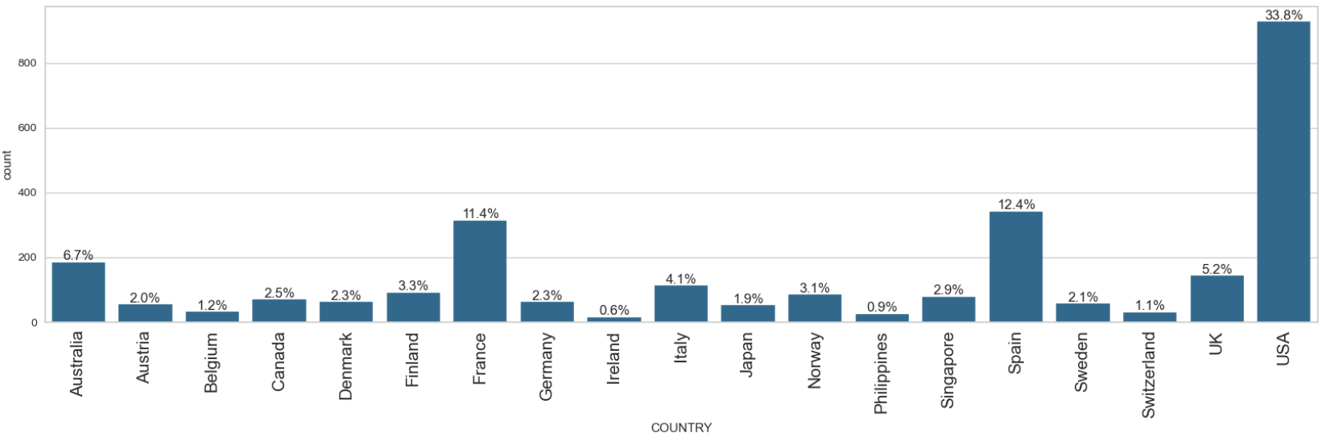
EXPLORATORY DATA ANALYSIS (5/13)
Univariate Analysis
Country of Customer:-
Majority of the customers belong to US (34%), followed by Spain (12%) & France (11%)
Other countries constitute 1-7% each.

Slide 12
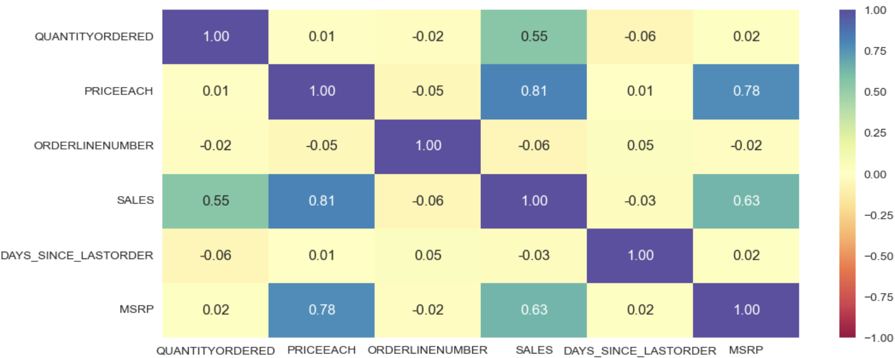
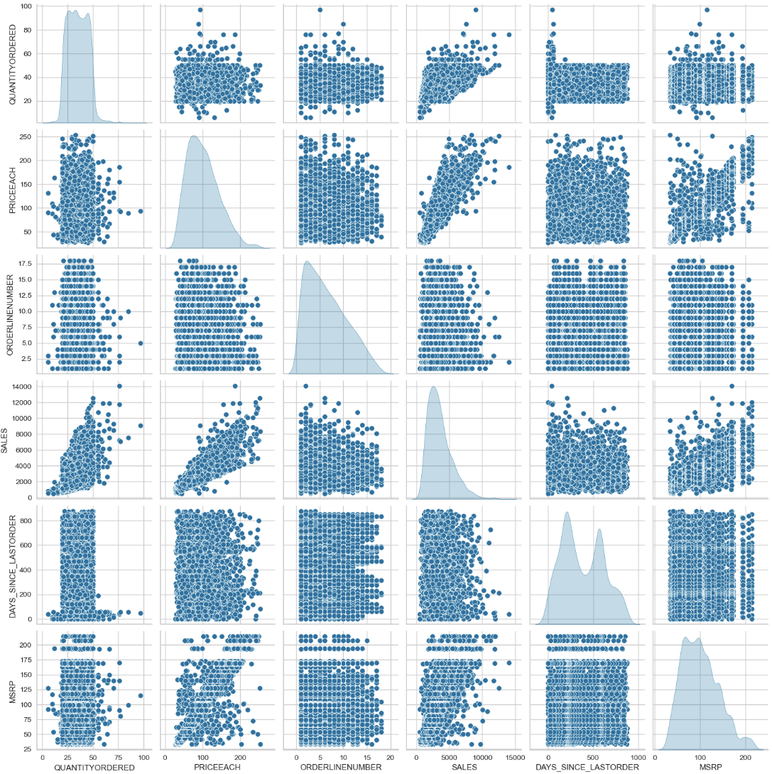
EXPLORATORY DATA ANALYSIS (6/13)
Bivariate Analysis – Heatmap & Pairplot
Correlation Inference between Numerical Variables:-
No significant correlation observed between variables of interest
Expected correlations observed:-
Between Sales & Price of Each Item – Expected as Price would impact sales directly
Between Price of Each Item & Manufacturer's Suggested Retail Price – Expected correlation
Between Sales & Manufacturer's Suggested Retail Price – Expected as Manufacturer's Retail Price would impact sales directly

Slide 13
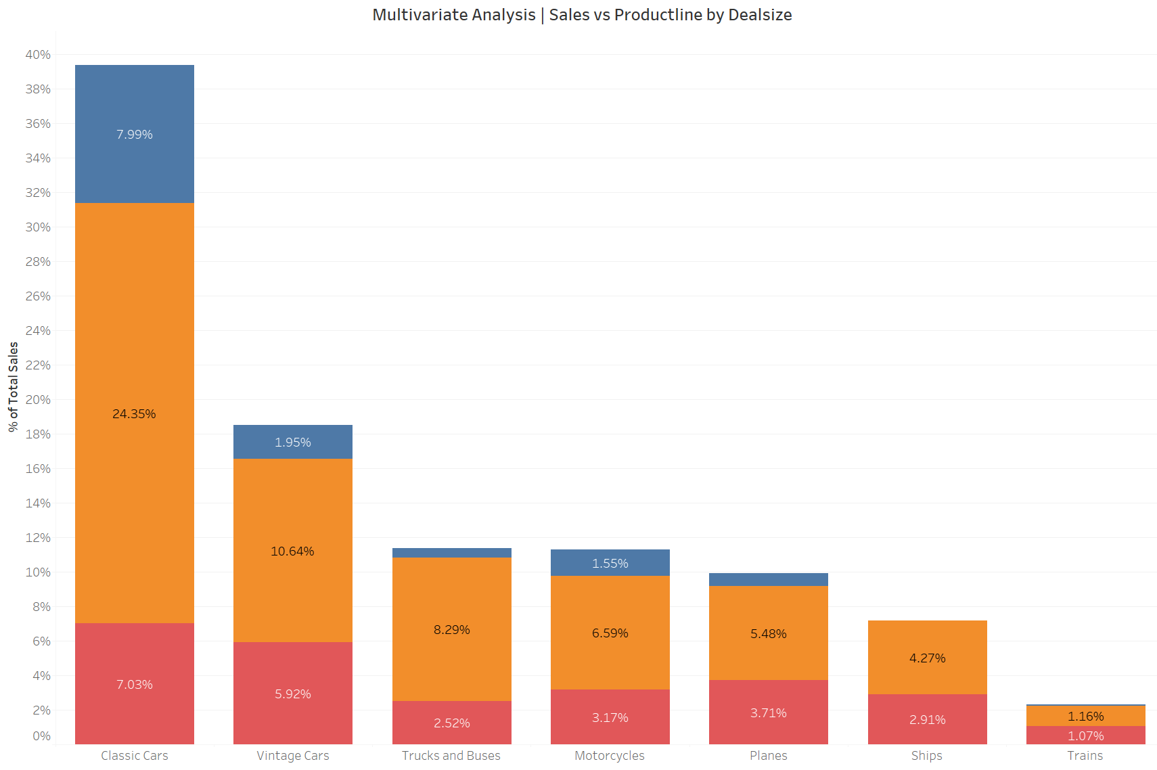
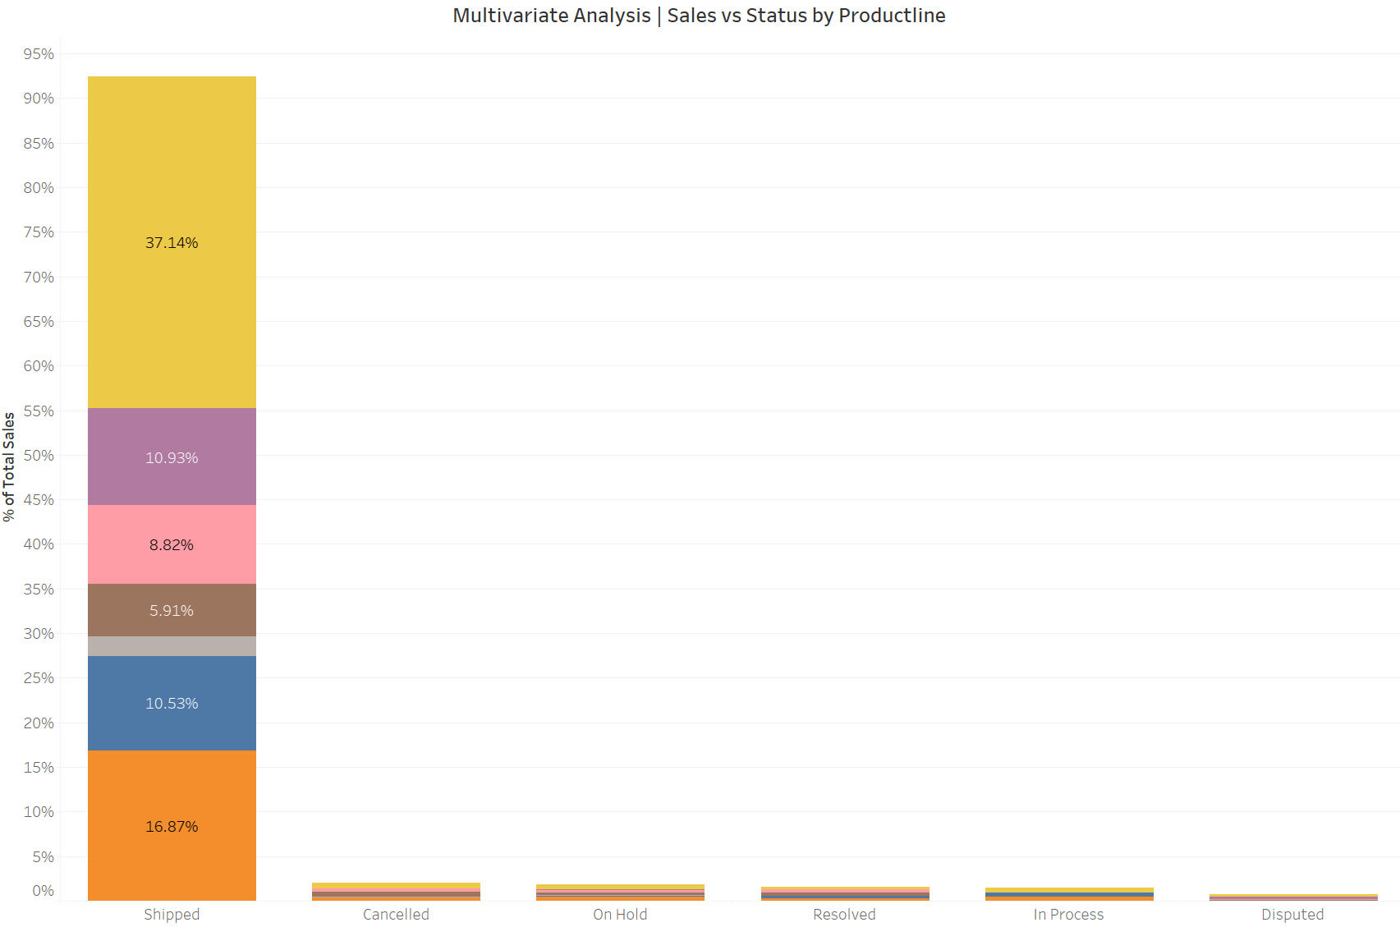
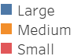
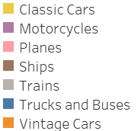
EXPLORATORY DATA ANALYSIS (7/13)
Bivariate/Multivariate Analysis
Sales vs Product Line & Deal Size:-
Clearly, Classic Car Parts contribute the most in terms of revenue (39%), followed by, Vintage Car Parts (19%)
Large & Medium Deal Size is mostly coming from Classic Cars category whereas Small Deal Size from Classic Car & Vintage Car parts
Sales vs Status & Product Line:-
92% of revenue is contributed by Shipped orders
Of the orders shipped, Classic Car & Vintage Car parts contribute the most (37% & 17% respectively)

Slide 14
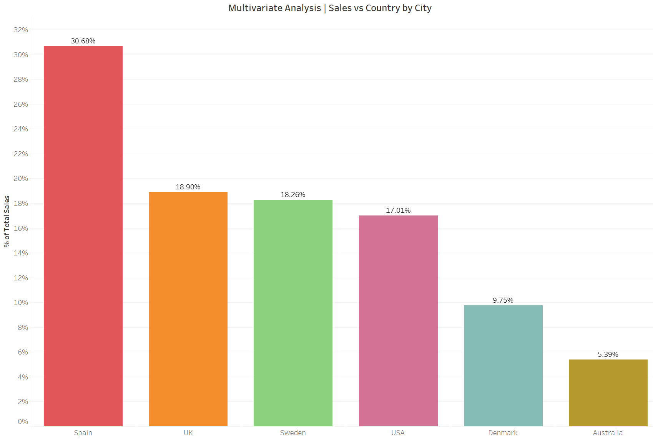
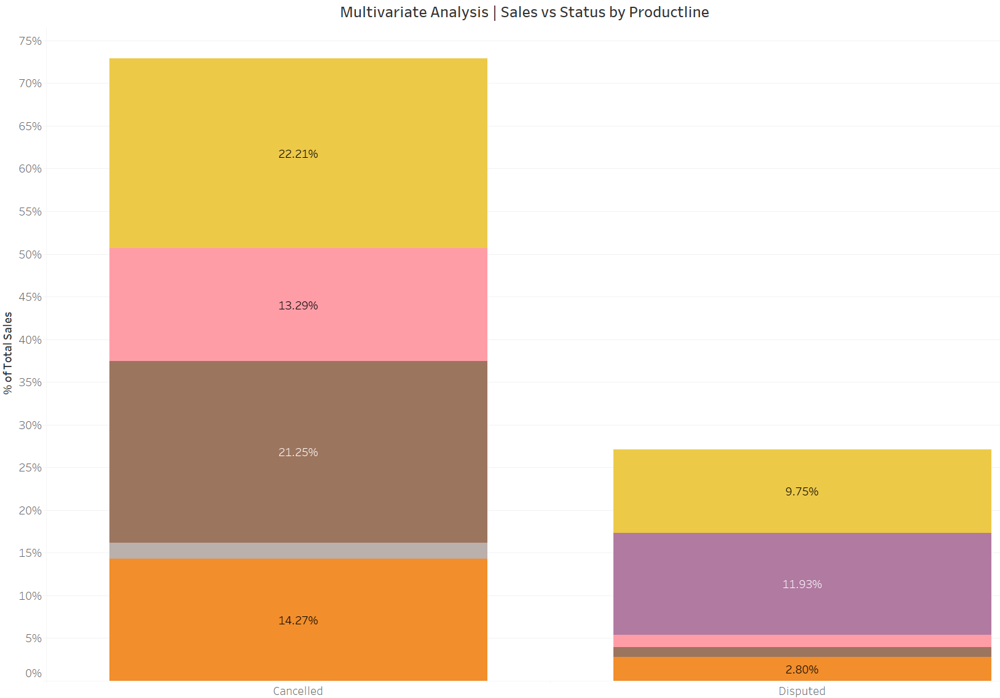
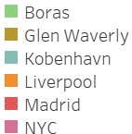
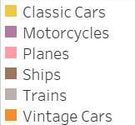
EXPLORATORY DATA ANALYSIS (8/13)
Bivariate/Multivariate Analysis – Disputed & Cancelled Orders
Sales Lost due to Disputed/Cancelled Orders by Country/City & Product Line:-
Max. Revenue Loss due to Disputed/Cancelled orders contributed by Spain (Madrid), followed by UK (Liverpool), Sweden (Boras), USA (NYC), Denmark (Kobenhavn) & Australia (Glen Waverly)
Ship parts suffer maximum Cancellations & Motorcycle parts suffer from maximum Disputed Orders

Slide 15
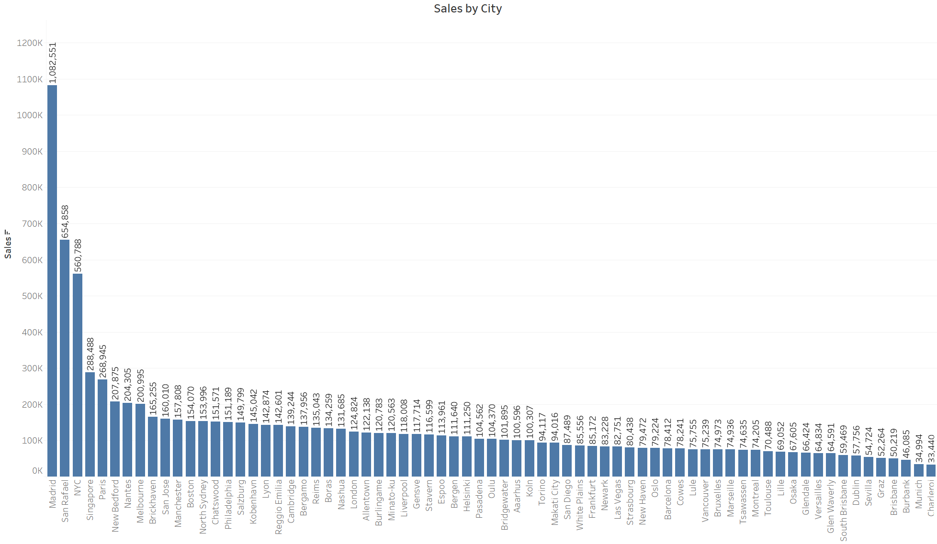
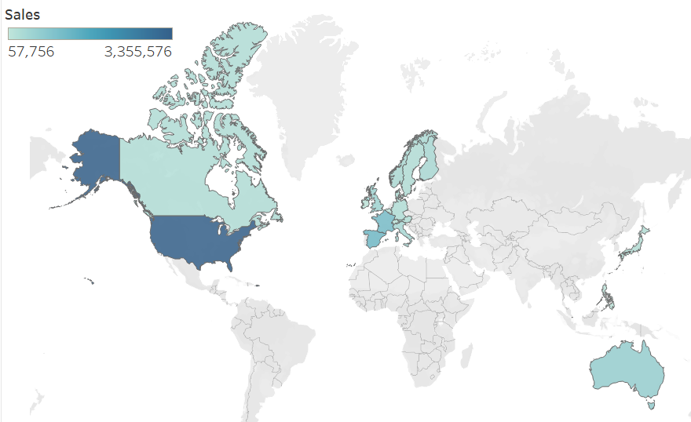
EXPLORATORY DATA ANALYSIS (9/13)
Bivariate/Multivariate Analysis – By Region
Sales by Country & City:-
In the previous slides we observed that majority of the orders came from US, Spain & France. However, US & Canada are contributing to majority of Revenue
US is dominating in terms of no. of orders & Revenue.
Top 3 Cities contributing to Revenue – Madrid, San Rafael & NYC

Slide 16
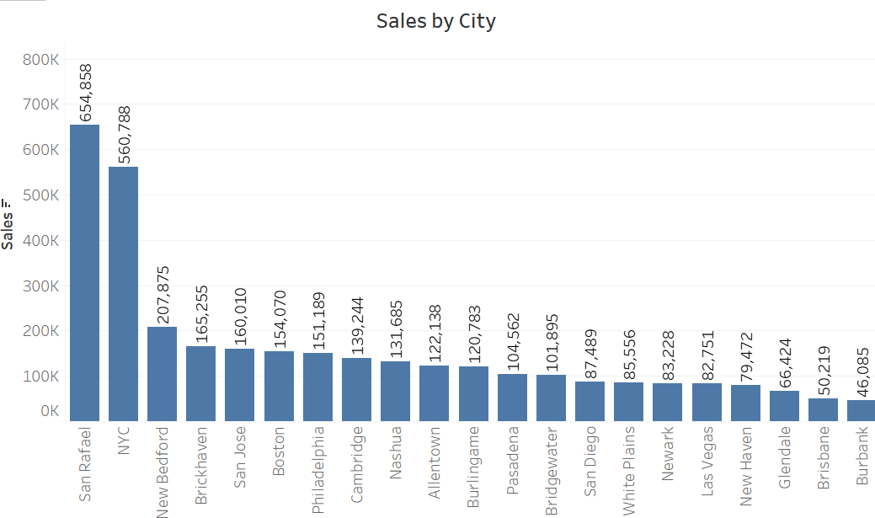
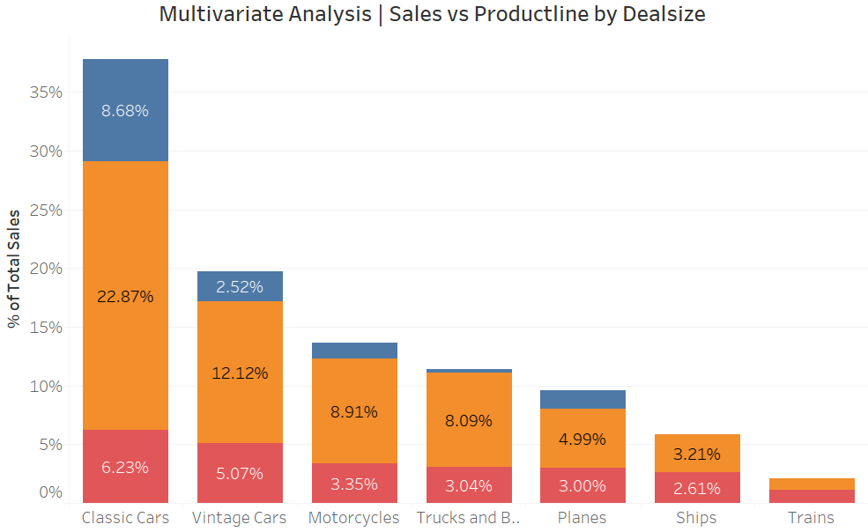
EXPLORATORY DATA ANALYSIS (10/13)
Bivariate/Multivariate Analysis – US Region
Sales by City & Product line/Deal size – US Region Drilldown
In the US Region, San Rafael & NYC significantly contribute to the revenue with 5X sales relative to other regions
Classic Car & Vintage Car partss are the top 2 contributors in terms of both the Product Category & Deal Size

Slide 17
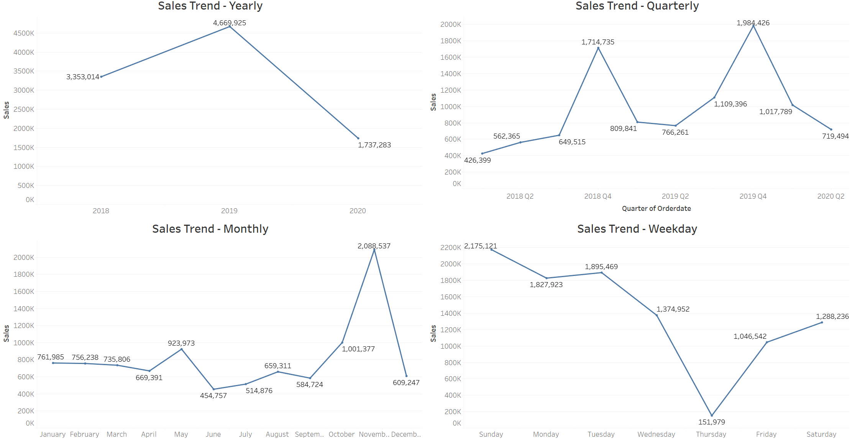
EXPLORATORY DATA ANALYSIS (11/13)
Bivariate/Multivariate Analysis – Sales Trend
Sales Trend –
Yearly, Quarterly, Monthly & Weekly
3 years data being analyzed
Even though the yearly trend suggests a decline, it cannot be ascertained as the data provided for 2020 is not complete (only 2 quarters data provided). If we interpolate the data for remaining quarters, the trend would seem stable (with slight negative bias).
Clear pattern of uptick in the Sales observed in the month of November
On weekly basis, sales on Thursdays is the lowest, relative to other weekdays. In fact, sales increase from Friday to Sun & drops from Monday to Thursday.

Slide 18








EXPLORATORY DATA ANALYSIS (12/13)
Key Takeaways
Insights – Seasonality
Stable (slight negative bias)
Annual Sales
Q4 (predominantly, Nov.)
has relatively higher Sales
Sales increase from Friday to Sunday and dip from Monday to Thursday
Thursday records the lowest Sales out of 7 days
Insights – General
‘Classic Car’ & ‘Vintage Car’ Parts record the highest Sales
US Region dominates – No. of orders & Revenue
Sales Superstars – Madrid (Spain), San Rafael (US) & NYC (US)
Top 5 Cities with Revenue Loss (Disputed/Cancelled Orders) – Madrid, Liverpool, Boras, NYC & Kobenhavn

Slide 19








EXPLORATORY DATA ANALYSIS (13/13)
Business Recommendations
Boost Q4 Campaigns, Especially in November – Leverage historically high Q4 sales by launching promotions and targeted marketing campaigns in this period.
Run Weekend-Focused Promotions – Capitalize on the Friday to Sunday sales spike with time-limited weekend deals and online advertising.
Address Weekday Sales Dip – Investigate and revamp marketing or engagement strategies for Monday to Thursday to smooth weekly sales volatility.
Promote Best-Selling Categories – Prioritize inventory, marketing, and bundling strategies around ‘Classic Car’ and ‘Vintage Car’ parts.
Strengthen Presence in the US Market – Reinforce supply chain, customer service, and marketing efforts in the dominant US region to sustain growth.
Expand High-Performing Cities – Replicate successful strategies from Madrid, San Rafael, and NYC in underperforming but similar cities.
Analyze and Mitigate Order Disputes – Investigate causes of cancellations/disputes in Madrid, Liverpool, Boras, NYC, and Kobenhavn to reduce potential revenue loss.
Launch Loyalty Programs – Reward frequent or high-spending customers in top regions and categories to boost retention and repeat purchases.

Slide 20
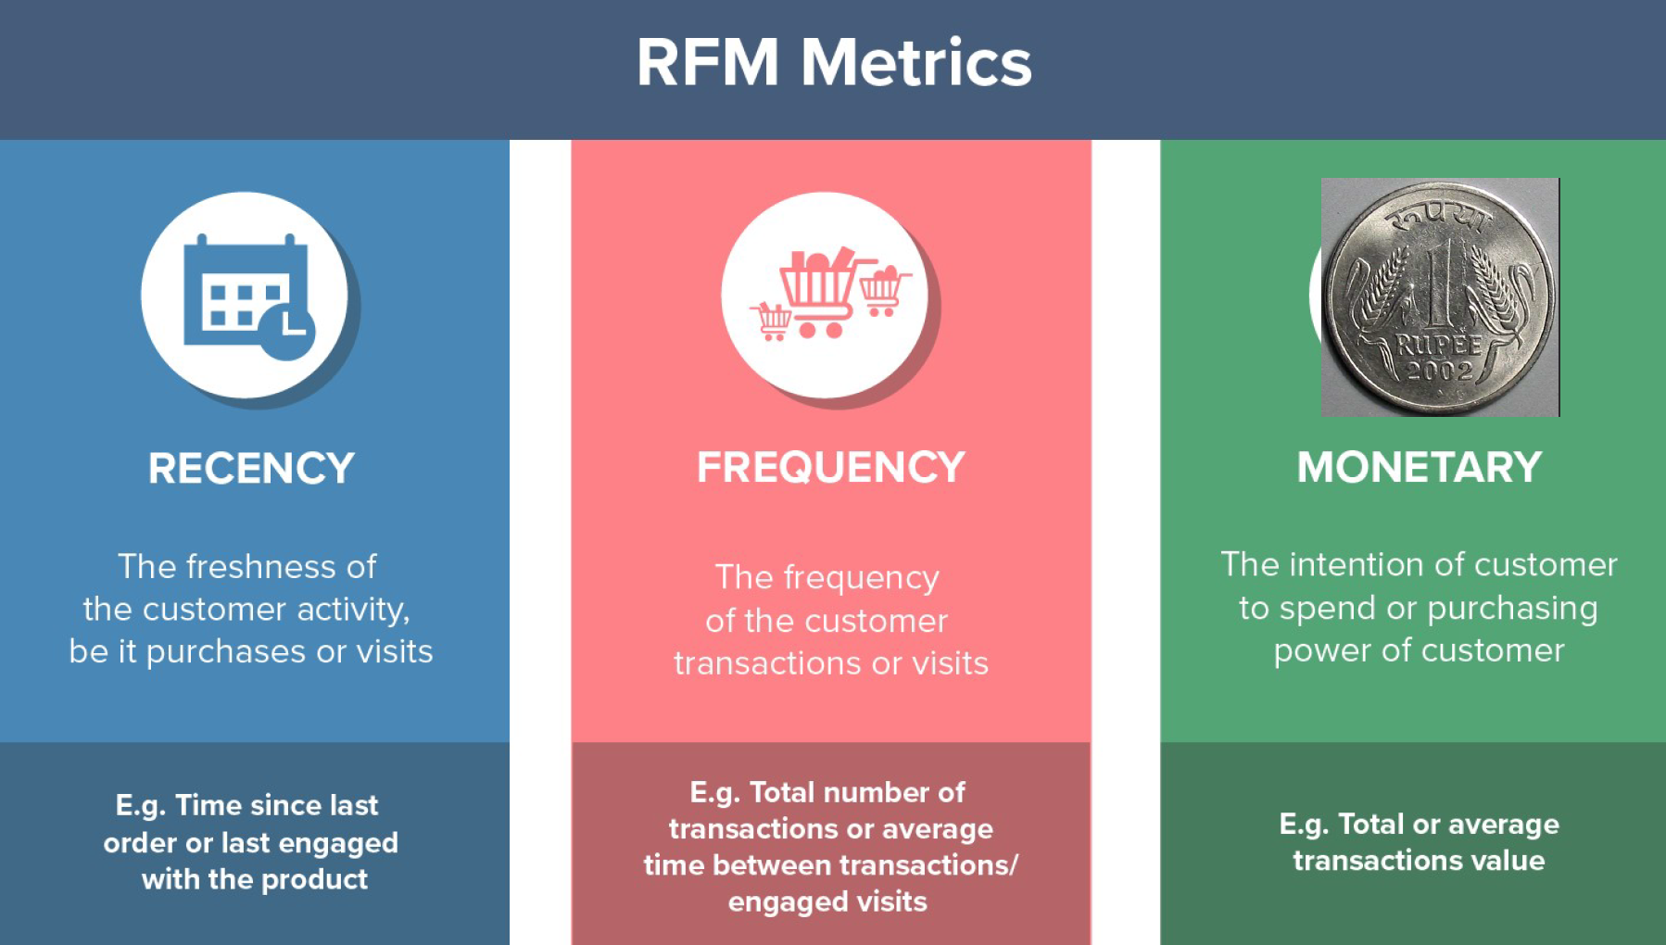

CUSTOMER SEGMENTATION USING RFM (1/9)
What is RFM?
Recency, Frequency, Monetary value (RFM) is a marketing analysis tool used to identify a firm’s best clients based on the nature of their spending habits.
An RFM analysis evaluates clients and customers by scoring them in three categories: how recently they’ve made a purchase, how often they buy, and the size of their purchases.
Tool Used for Analysis:-
KNIME, the Konstanz Information Miner, is a free and open-source data analytics, reporting and integration platform.
KNIME shall be used to carry our customer segmentation in subsequent slides

Slide 21


CUSTOMER SEGMENTATION USING RFM (2/9)
Parameters Used
Assumptions Made
Recency:-
As per instructions the column 'Days since last order’ has been ignored
New column Recency has been created as '[Max(order date)-order date]’
As per above formula, we have used ‘01-06-2020’ as a reference date and created Recency column.
Frequency:-
Frequency value is calculated by counting all the Orders made by a Customer, i.e. Aggregate Count(ORDERNUMBER) Group By (CUSTOMERNAME)
Monetary:-
Monetary value is the same as SALES (i.e. Quantity X Price). Since this field is already present, need not compute it again.
Clustering:-
K-Means Clustering carried out to create additional clusters based on Recency, Frequency & Monetary Values computed above, which can be correlated later for final segmentation.
All the orders having status apart form ‘SHIPPED’ were also considered as a valid business transactions.
For calculating recency, we have taken the last ‘ORDERDATE’ as reference.
3 Bins (Quantiles-logic) has been created for Recency, Frequency & Monetary values.
3 Bins have been labeled as High (H), Medium (M), and Low (L).
For Recency, Bin 1 has been considered highest as lower value is better.
For Frequency & Monetary, Bin 3 has been considered highest as higher is better.

Slide 22
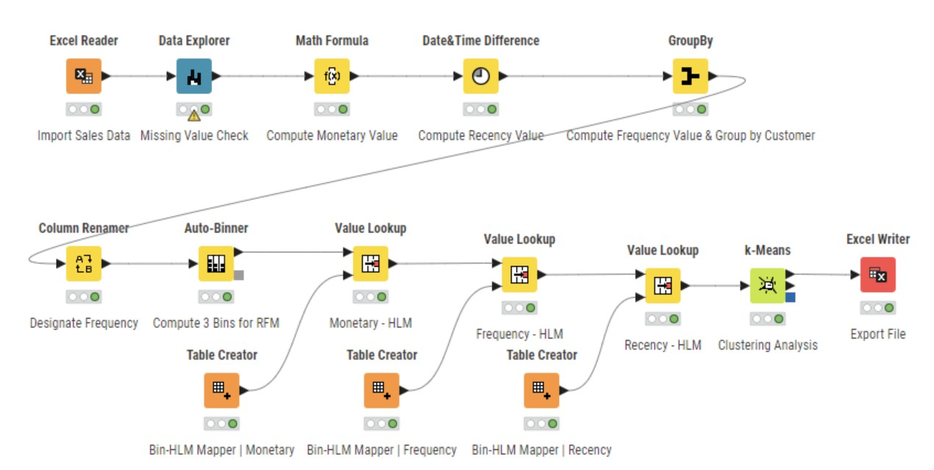
CUSTOMER SEGMENTATION USING RFM (3/9)
KNIME Workflow for RFM Analysis
**
** ORDERDATE is excluded from Data Explorer Node calculation

Slide 23
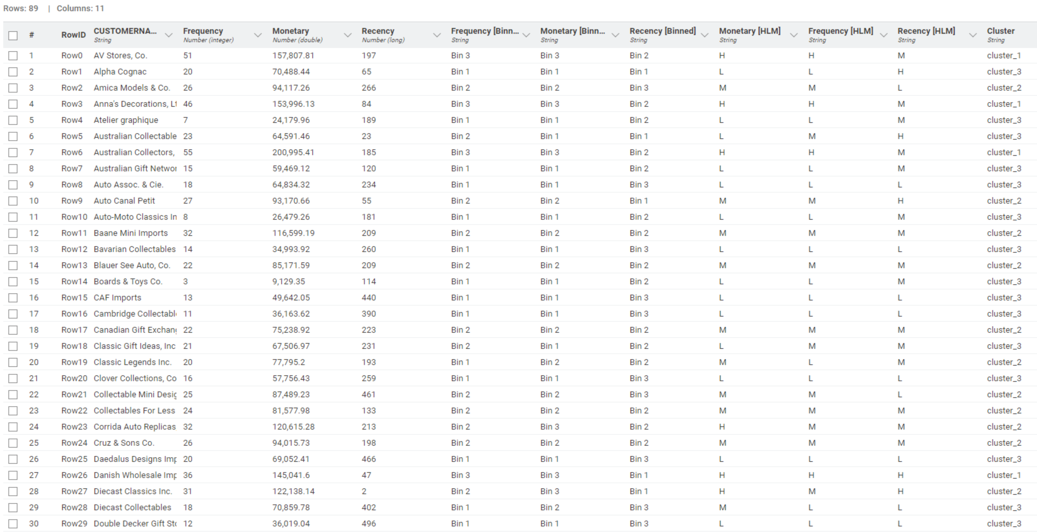
CUSTOMER SEGMENTATION USING RFM (4/9)
RFM Output Table from KNIME Workflow (Top 30 Rows)

Slide 24
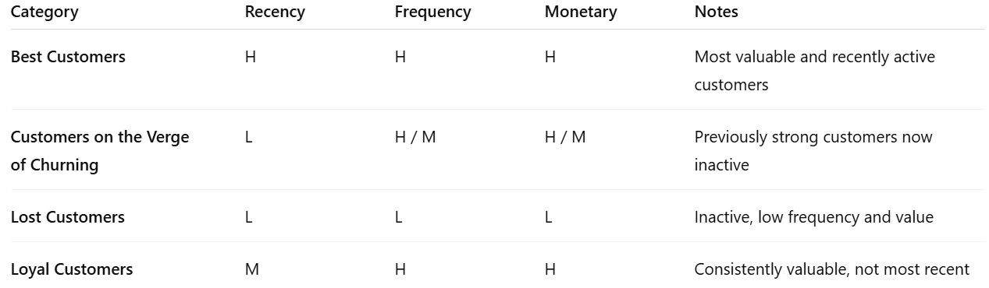
CUSTOMER SEGMENTATION USING RFM (5/9)
Customer Segmentation Rationale
RFM Analysis has been primarily used to distinguish between Best, Verge of Churning, Lost & Loyal Customers.
K-Means Clustering was only used as a secondary recommendation model to validate segmentation.
Customer Segmentation rationale has been summarized in the table below:-

Slide 25
CUSTOMER SEGMENTATION USING RFM (6/9)
Best Customers
Citeria – Recency = H | Frequency = H | Monetary = H
These customers Buy frequently, Spend a lot and Purchased recently
They are engaged, valuable, and loyal right now — the core of the business.
Below are the top 5 Best Customers, sorted by Recency value (ascending order)
CUSTOMERNAME | Frequency | Monetary | Recency | Monetary [HLM] | Frequency [HLM] | Recency [HLM]
Euro Shopping Channel | 259 | 912294.11 | 1 | H | H | H
La Rochelle Gifts | 53 | 180124.90 | 1 | H | H | H
Mini Gifts Distributors Ltd. | 180 | 654858.06 | 3 | H | H | H
Souveniers And Things Co. | 46 | 151570.98 | 3 | H | H | H
Salzburg Collectables | 40 | 149798.63 | 15 | H | H | H

Slide 26
CUSTOMER SEGMENTATION USING RFM (7/9)
Customers on the Verge of Churning
Citeria – Recency = L | Frequency = H or M | Monetary = H or M
These customers Used to be active and valuable, Haven’t purchased in a long time and there’s a Risk they may stop buying permanently
They once offered value to the business, but now are at the risk of getting churned
Below are the top 5 Customers on the Verge of Churning, sorted by Monetary value (descending order)
CUSTOMERNAME | Frequency | Monetary | Recency | Monetary [HLM] | Frequency [HLM] | Recency [HLM]
Saveley & Henriot, Co. | 41 | 142874.25 | 457 | H | H | L
Vida Sport, Ltd | 31 | 117713.56 | 276 | M | M | L
Herkku Gifts | 29 | 111640.28 | 272 | M | M | L
Marta's Replicas Co. | 27 | 103080.38 | 232 | M | M | L
Amica Models & Co. | 26 | 94117.26 | 266 | M | M | L

Slide 27
CUSTOMER SEGMENTATION USING RFM (8/9)
Lost Customers
Citeria – Recency = L | Frequency = L | Monetary = L
These customers Rarely bought, Didn’t spend much and Haven’t returned in a long time
They have low value across the board and likely churned completely
Below are the top 5 Lost Customers, sorted by Recency value (descending order)
CUSTOMERNAME | Frequency | Monetary | Recency | Monetary [HLM] | Frequency [HLM] | Recency [HLM]
Double Decker Gift Stores, Ltd | 12 | 36019.04 | 496 | L | L | L
West Coast Collectables Co. | 13 | 46084.64 | 489 | L | L | L
Signal Collectibles Ltd. | 15 | 50218.51 | 477 | L | L | L
Daedalus Designs Imports | 20 | 69052.41 | 466 | L | L | L
CAF Imports | 13 | 49642.05 | 440 | L | L | L

Slide 28
CUSTOMER SEGMENTATION USING RFM (9/9)
Loyal Customers
Citeria – Recency = M | Frequency = H | Monetary = H
These customers Buy often, Spend a lot and May not always be very recent but are consistently valuable
They form the backbone of the revenue stream
Below are the top 5 Loyal Customers, sorted by Monetary value (descending order)
CUSTOMERNAME | Frequency | Monetary | Recency | Monetary [HLM] | Frequency [HLM] | Recency [HLM]
Australian Collectors, Co. | 55 | 200995.41 | 185 | H | H | M
Muscle Machine Inc | 48 | 197736.94 | 183 | H | H | M
Dragon Souveniers, Ltd. | 43 | 172989.68 | 91 | H | H | M
Land of Toys Inc. | 49 | 164069.44 | 199 | H | H | M
AV Stores, Co. | 51 | 157807.81 | 197 | H | H | M

Slide 29




INFERENCES & BUSINESS RECOMMENDATIONS
Business Recommendations based on Customer Segmentation
BEST CUSTOMERS
LOYAL CUSTOMERS
GOAL
Maximize their lifetime value, reduce the chance of defection, and turn them into brand advocates.
GOAL
Deepen the relationship, encourage higher spending and longer retention.
STRATEGY
Retention-focused: Keep them loyal and delighted
VIP Programs: Offer early access, exclusive products, or events
Surprise & Delight: Thank-you gifts, handwritten notes, birthday offers.
Referral Incentives: Encourage them to bring in others with similar traits.
Feedback Loops: Use their input to improve products/services.
STRATEGY
Loyalty programs: Points-based rewards or tiered benefits
Subscription or bundling options: Make it easier to buy regularly
Exclusive experiences: Beta testing, private previews, “insider” content
Recognition: Feature them in customer stories or shout-outs
Cross-selling/Upselling: Suggest complementary high-margin products
CUSTOMERS ON THE VERGE OF CHURNING
LOST CUSTOMERS
GOAL
Re-engage them before they slip into the "lost" category
GOAL
Limit acquisition/retention costs; only re-engage if ROI is favorable.
STRATEGY
Reactivation campaigns: Send personalized "We miss you" messages
Time-limited offers: Discounts or incentives with urgency
Product reminders: Recommend items based on their past purchases
Multi-channel outreach: Use SMS, email, social, or retargeted ads
Ask why: Quick surveys to understand their disengagement
STRATEGY
Low-cost reactivation: Batch-target them with seasonal or clearance promotions.
Re-acquisition campaigns: Treat like new leads with onboarding-style emails
Exit feedback: Ask why they left (if willing)
Segment wisely: Don’t overspend trying to win them back

Slide 30
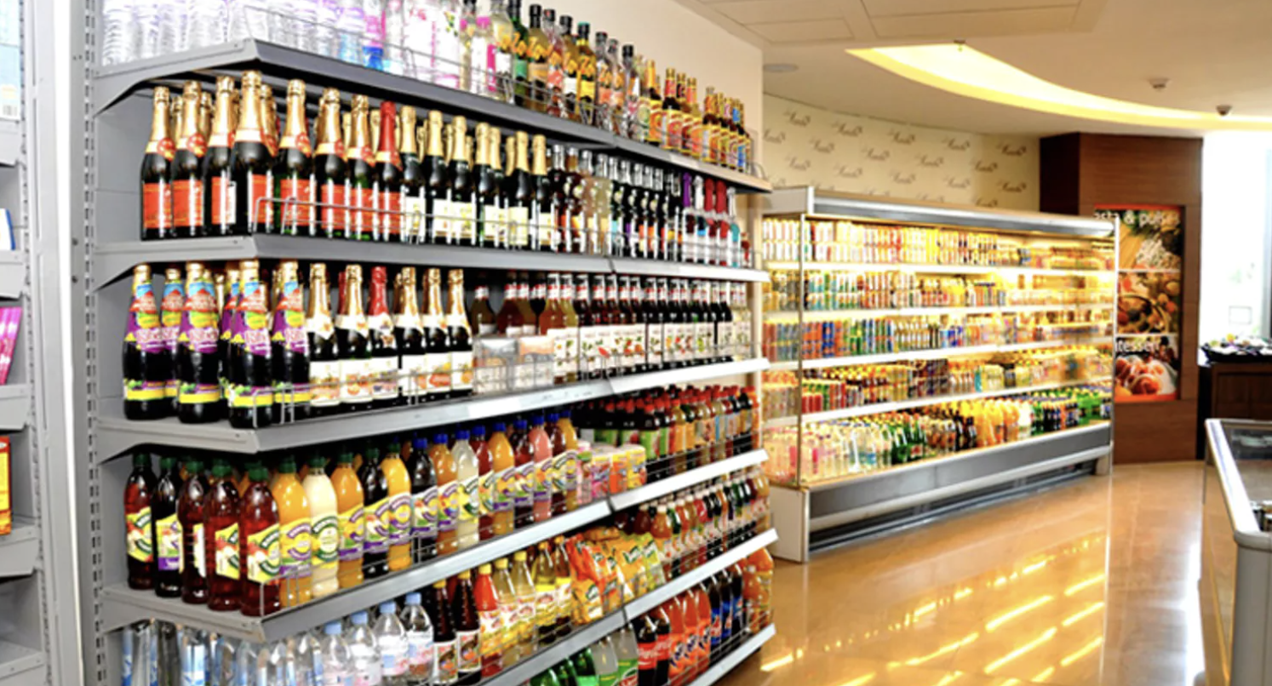
PART B – Grocery Retail Problem

Slide 31
BUSINESS CONTEXT & PROBLEM STATEMENT
Business Context
A Grocery Store – shared transactional data
Wish to leverage Analytics to understand customer buying patterns for enhancing sales, increasing customer satisfaction and improving profitability
Aims to identifying frequently purchased item combinations to craft effective marketing strategies, optimize inventory management and tailor promotions to meet customer needs
Drive customer-centric offerings which can increase basket size and improve customer retention.
Problem Statement / Objective
Analyze the POS transactional data to identify frequently purchased item combinations
Using association rule mining or similar techniques to uncover patterns that will help the store create targeted combo offers and discounts
Ultimate goal is to drive revenue growth by increasing customer purchases and average basket size

Slide 32
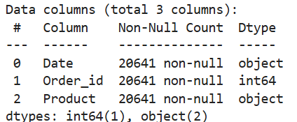
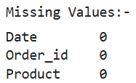
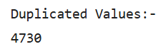
DATA SUMMARY (1/2)
Data Dictionary & Data Information
Data Dictionary:-
Date: The date when the transaction took place
Order_id: A unique identifier for each customer order
Product: The individual item purchased in the transaction
Duplicate Values:-
Dropping duplicate rows may not be appropriate as there is no unique identifier for each row.
Each row consists of a date, a customer ID, and a product purchased, but the same product can be purchased by multiple customers on the same date.
If we drop duplicate rows; it may inadvertently remove valid information from the dataset.
Hence, duplicate values have not been removed from the dataset

Slide 33
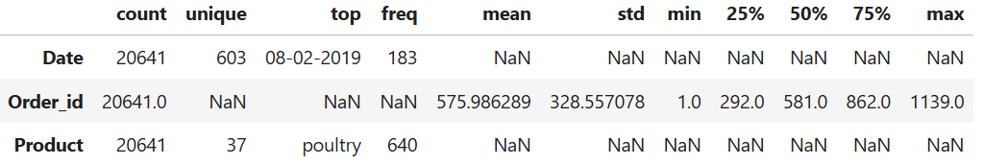
DATA SUMMARY (2/2)
Data Description
Data Inference
Data: Past 3 years.
Dataset: 3 columns and 20641 rows
Missing values: None
Duplicate values: 4730 | More than one quantity of a product bought in a single order. Hence, not removed (please refer previous slide)
Order_id is an identifier and finding outliers is meaningless
There are a total of 37 unique products in the Grocery Store, among which poultry is the highest sold product.
Maximum no. of products were bought on 08/02/2019 (183 items)
Assumptions: -
Data represents a list of items purchased at a grocery store on various dates.
Each entry represents a single item purchased.
The same item can be purchased by multiple customers on different dates.
Duplicated values were not dropped to avoid any loss of information

Slide 34
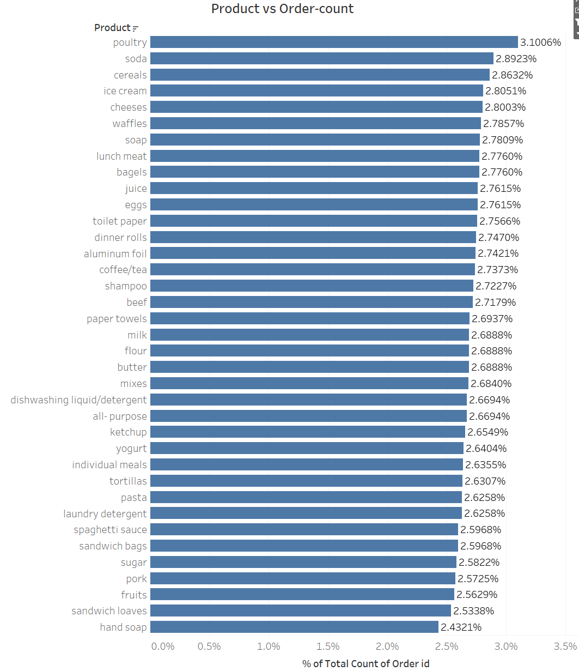
EXPLORATORY DATA ANALYSIS (1/8)
Univariate Analysis
Product:-
Poultry dominates the item list purchased, followed by Soda & Cereals
Top 3 products – poultry, soda, cereals
Order ID:-
Since, it is an identifier, its distribution is meaningless
Date:-
Distribution of date is meaningless.
Bivariate analysis with Date would be covered under Trends section

Slide 35
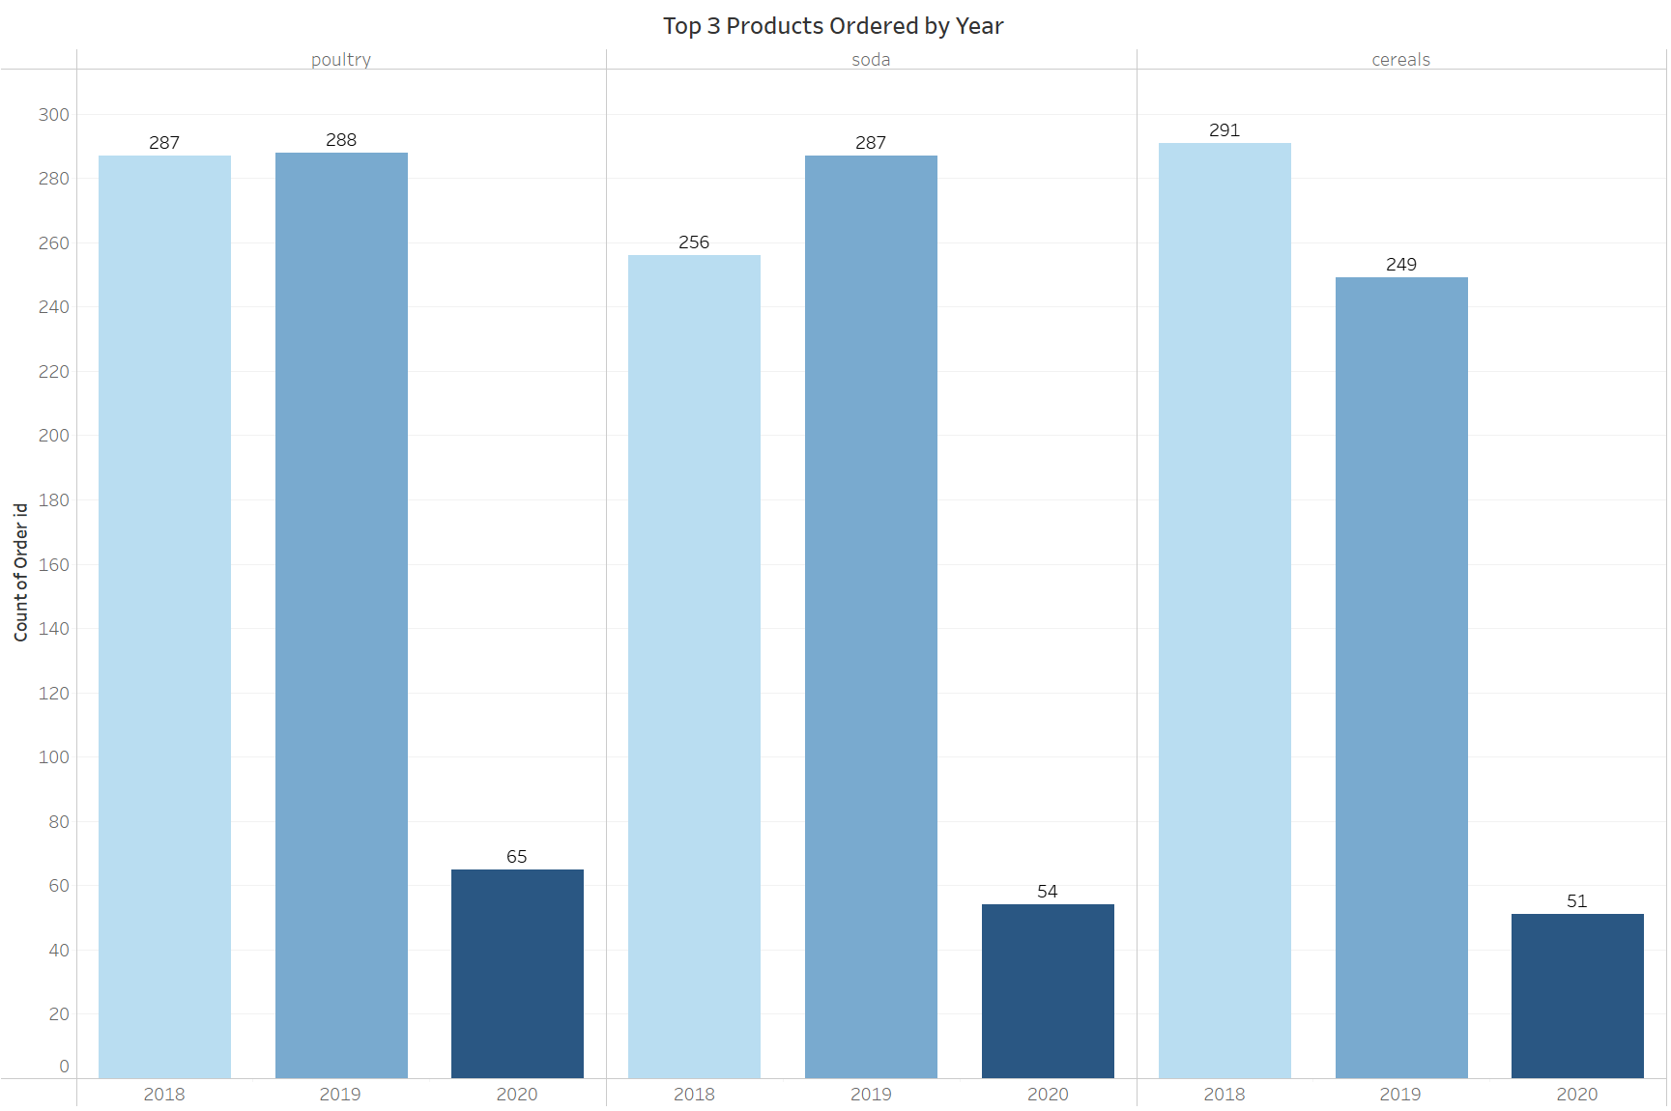
EXPLORATORY DATA ANALYSIS (2/8)
Bivariate/Multivariate Analysis
Even though the data suggests a sharp fall in each of the product orders (poultry, soda, cereals), it cannot be ascertained as the data for 2020 is not compete (only till Q1). Interpolating the data may suggest a slight decline on the overall trend.
Poultry – stable orders in 2018 & 2019
Soda – slight increase in orders from 2018 to 2019
Cereals – Sharp decline seen in orders from 2018 to 2019

Slide 36
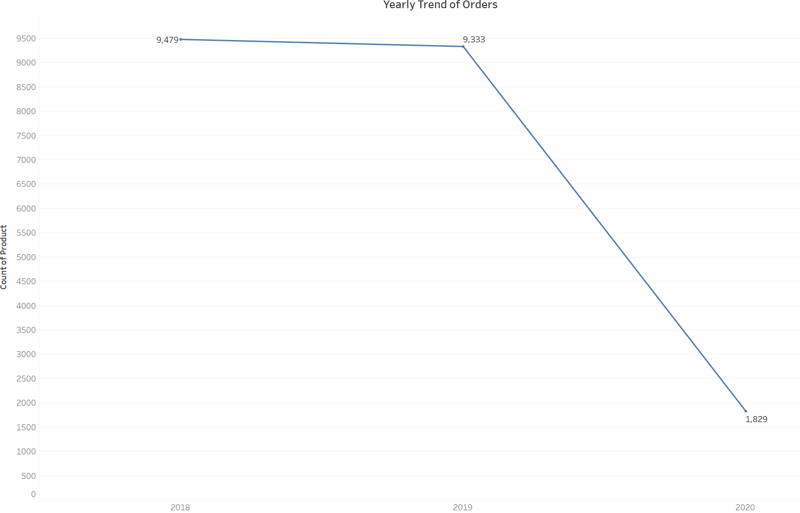
EXPLORATORY DATA ANALYSIS (3/8)
Bivariate/Multivariate Analysis – Yearly Trends
Products sold in 2018 & 2019 remained fairly stable at around 9300-9500 orders
The chart shows a decline, but cannot be ascertained as data is not complete for 2020 (data till Q1 only)
However, if we interpolate, it may imply 2020 observing decline in the order trend. However, this is just a conjecture & cannot be ascertained at this moment. Time series forecasting techniques can be deployed to establish a level of confidence in this conjecture.

Slide 37
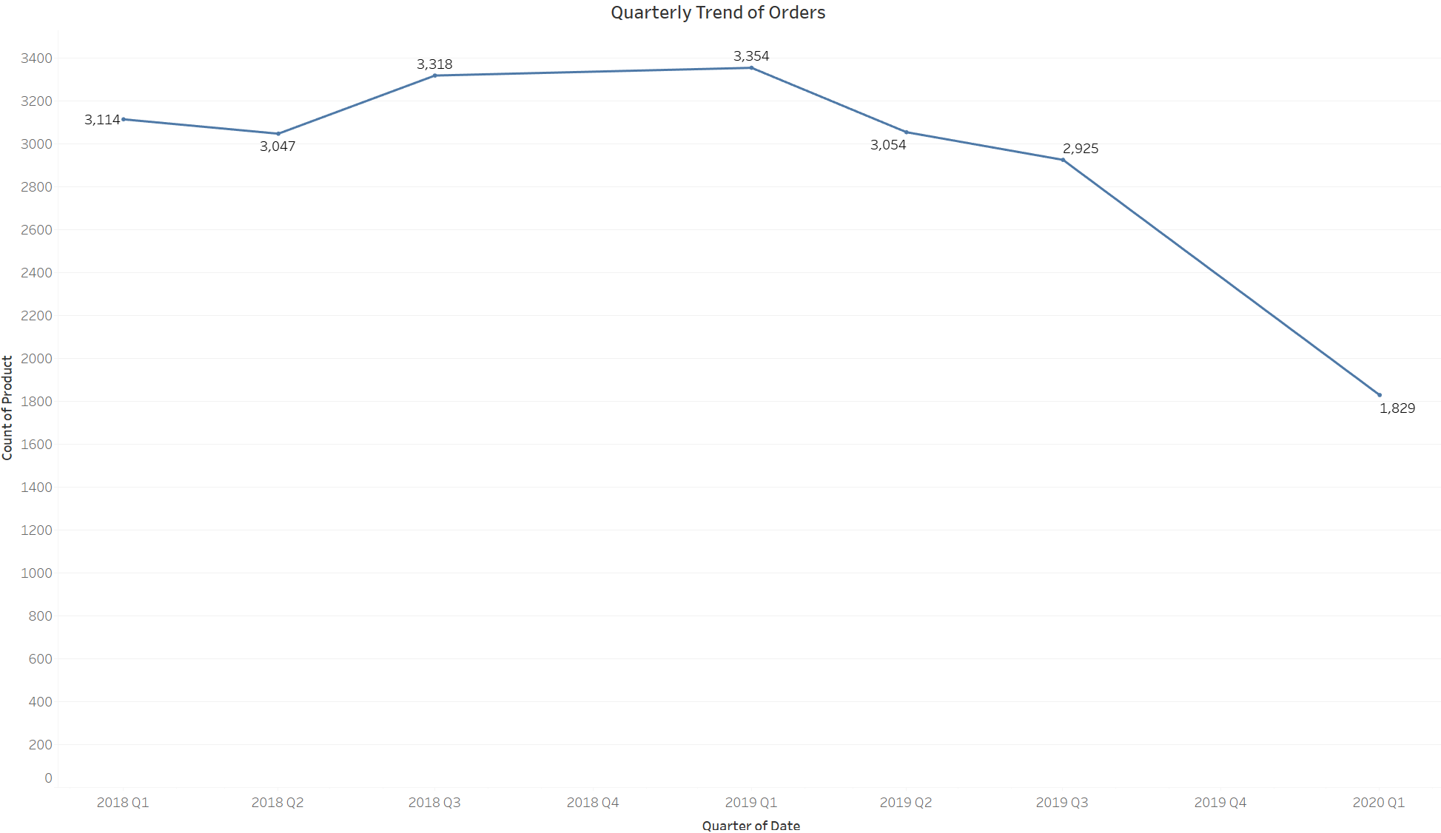
EXPLORATORY DATA ANALYSIS (4/8)
Bivariate/Multivariate Analysis – Quarterly Trends
Products sold in 2018 over Q1 through Q4 was fairly stable
Products sold in 2019 Q1 & Q2 were similar to 2018, however, a sharp fall observed in 2019 Q3 & Q4.
Poor performance & further decline extended till 2020 Q1.
Data clearly suggest a fall in performance, requiring immediate attention.

Slide 38
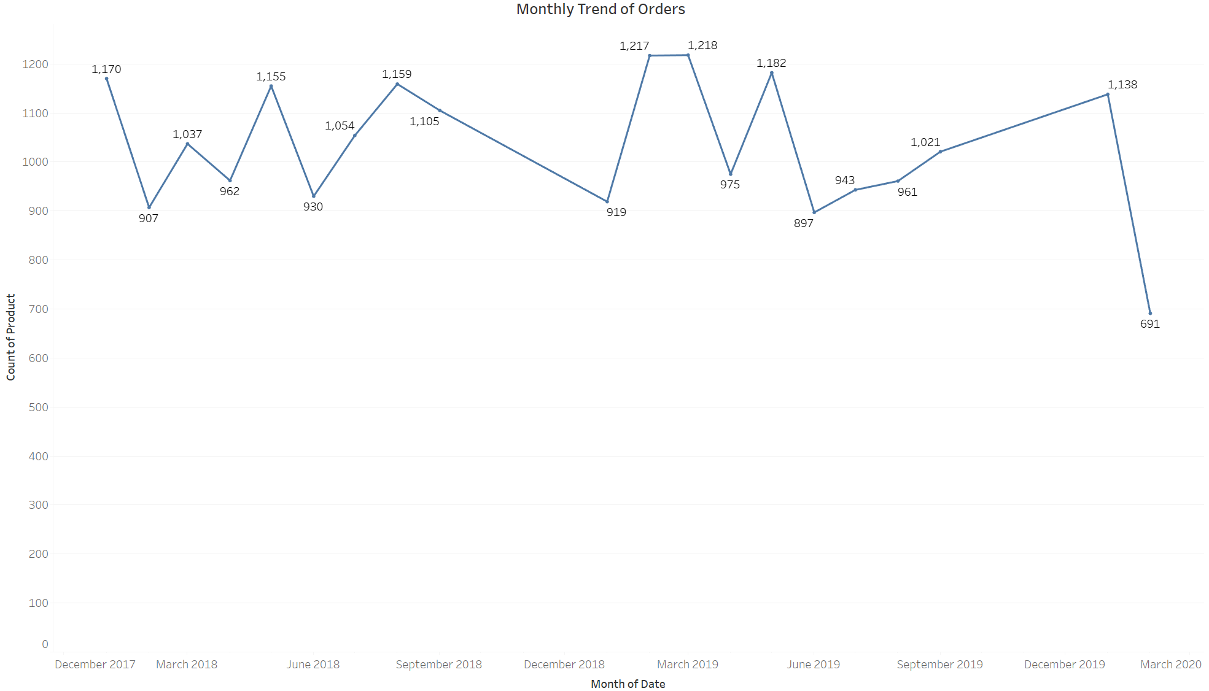
EXPLORATORY DATA ANALYSIS (5/8)
Bivariate/Multivariate Analysis – Monthly Trends
Monthly trend is erratic & suggests no pattern
No seasonality observed across the year
This makes sense also since most of the products sold are FMCG, that have pretty much the same demand all round the year.

Slide 39
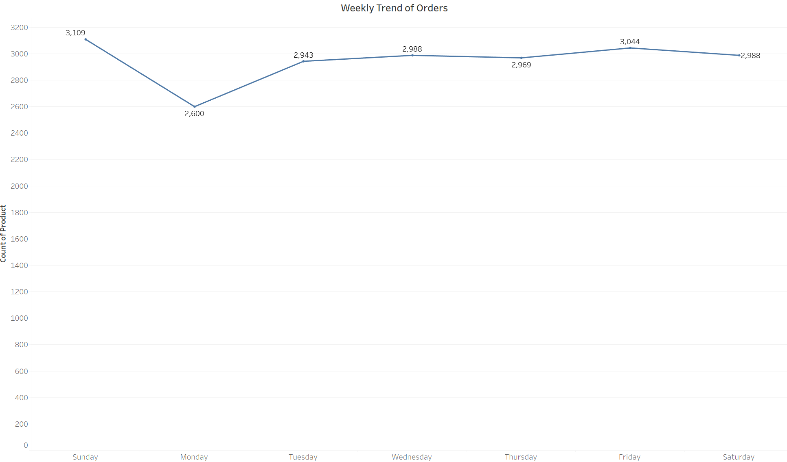
EXPLORATORY DATA ANALYSIS (6/8)
Bivariate/Multivariate Analysis – Weekday Trends
Products sold on Sunday is the highest, which makes sense as it is an off day for most of the working people
Friday is the second highest after Sunday, suggesting people buying Friday evening as they gear up for the weekend.
Lowest no. of products are sold on Monday.

Slide 40






EXPLORATORY DATA ANALYSIS (7/8)
Key Takeaways
Insights – General
Product Sales declining trend from 2019 Q3 onwards
Top 3 Products Sold – Poultry, Soda, Cereals
Poultry, Soda – stable/increasing trend in sales; Cereals – declining trend
No monthly seasonal trend
Sunday & Friday record maximum sales relative to other days
Monday records lowest sales relative to other days

Slide 41




EXPLORATORY DATA ANALYSIS (8/8)
Business Recommendations
Investigate Causes of Overall Sales Decline since Q3 2019 and implement corrective strategies such as refreshed product offerings or targeted promotions
Leverage High-Performing Products like Poultry and Soda through prominent shelf placement and bundled offers to boost basket size
Reevaluate Cereals Category by analyzing customer preferences, pricing, and competitor offerings to revive sales
Avoid Overreliance on Seasonal Campaigns, as no monthly seasonality exists; instead, maintain consistent promotions year-round
Focus Promotions on High-Traffic Days (Sunday & Friday) to capitalize on peak sales periods and increase average spend
Introduce Monday-Specific Deals or Loyalty Rewards to uplift sales on the lowest-performing day
Enhance Inventory Planning for Poultry and Soda, ensuring availability during high-demand days to prevent stockouts
Use POS Data for Personalized Offers, targeting customers based on purchase history to increase frequency and retention

Slide 42
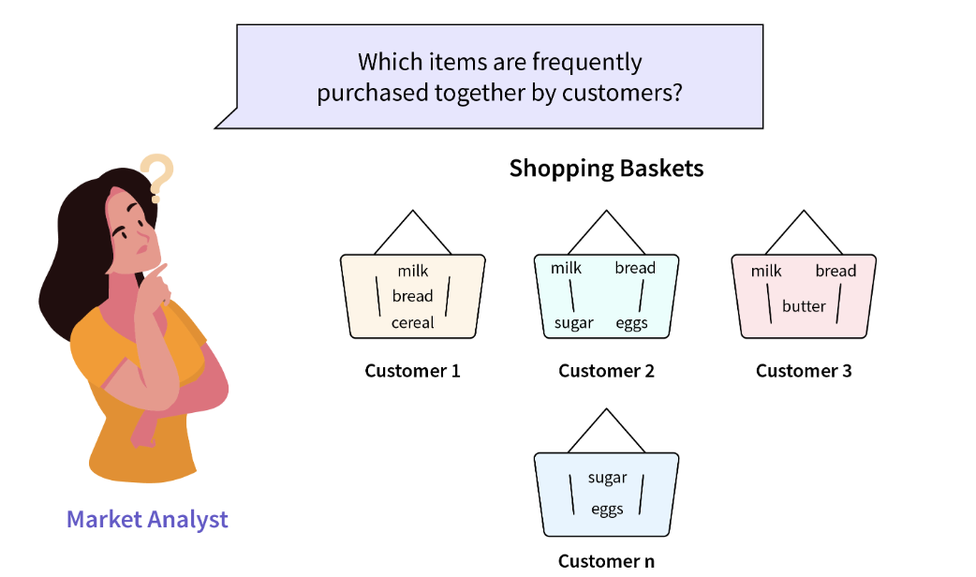
MARKET BASKET ANALYSIS (1/5)
What is Market Basket Analysis?
Market Basket Analysis is a techniques used by large retailers to uncover the association between items or to identify the relationship between items which are bought together more frequently.
Support – Support measures the frequency of occurrence of an item or itemset within a dataset of transactions. It's the proportion of transactions that contain the specific item or itemset.
Confidence – Confidence quantifies the probability that, given the purchase of an antecedent item, the consequent item is also purchased in the same transaction. It's the ratio of transactions containing both items (antecedent and consequent) to the transactions containing only the antecedent.
Lift – Lift measures the strength of the association between two items by comparing the observed probability of their co-occurrence to the expected probability if they were independent. It's the ratio of the observed support of the association to the product of the individual supports of the antecedent and consequent.
Tool Used for Analysis:-
KNIME, the Konstanz Information Miner, is a free and open-source data analytics, reporting and integration platform.
KNIME shall be used to carry our Market Basket Analysis in subsequent slides

Slide 43
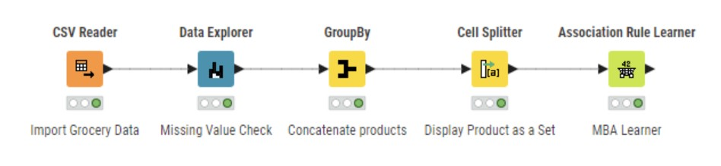
MARKET BASKET ANALYSIS (2/5)
KNIME Workflow for Market Basket Analysis

Slide 44
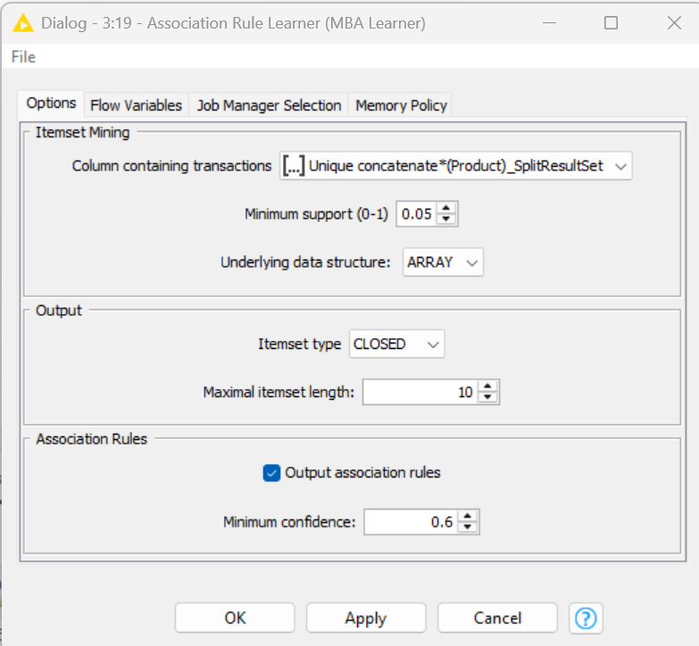
MARKET BASKET ANALYSIS (3/5)
Threshold Values Used
The above KNIME Workflow has been used to determine the rule using Association Learner Rule.
Following Thresholds have been used: -
Minimum Support = 0.05
Def: The minimum percentage of transactions in which an itemset must appear to be considered frequent.
Value 0.05 means: The itemset must appear in at least 5% of all transactions.
Implication: Filters out very rare itemsets; Helps focus only on patterns that are relatively common; A lower value gives more rules (including rare ones), while, a higher value gives fewer, more significant rules.
Minimum Confidence = 0.6
Def: The minimum probability that the consequent occurs given the antecedent.
Value 0.6 means: At least 60% of the time, when the antecedent items are bought, the consequent item is also bought.
Implication: Filters out weak or uncertain rules; Ensures the rules one gets are reliable for making recommendations; A higher confidence means stronger and more actionable rules.
Maximum itemset length = 10
Def: The maximum number of items in any frequent itemset or rule (antecedent + consequent).
Value 10 means: The rule can include up to 10 items.
Implication: Allows for more complex and broader rules, capturing long purchase patterns

Slide 45
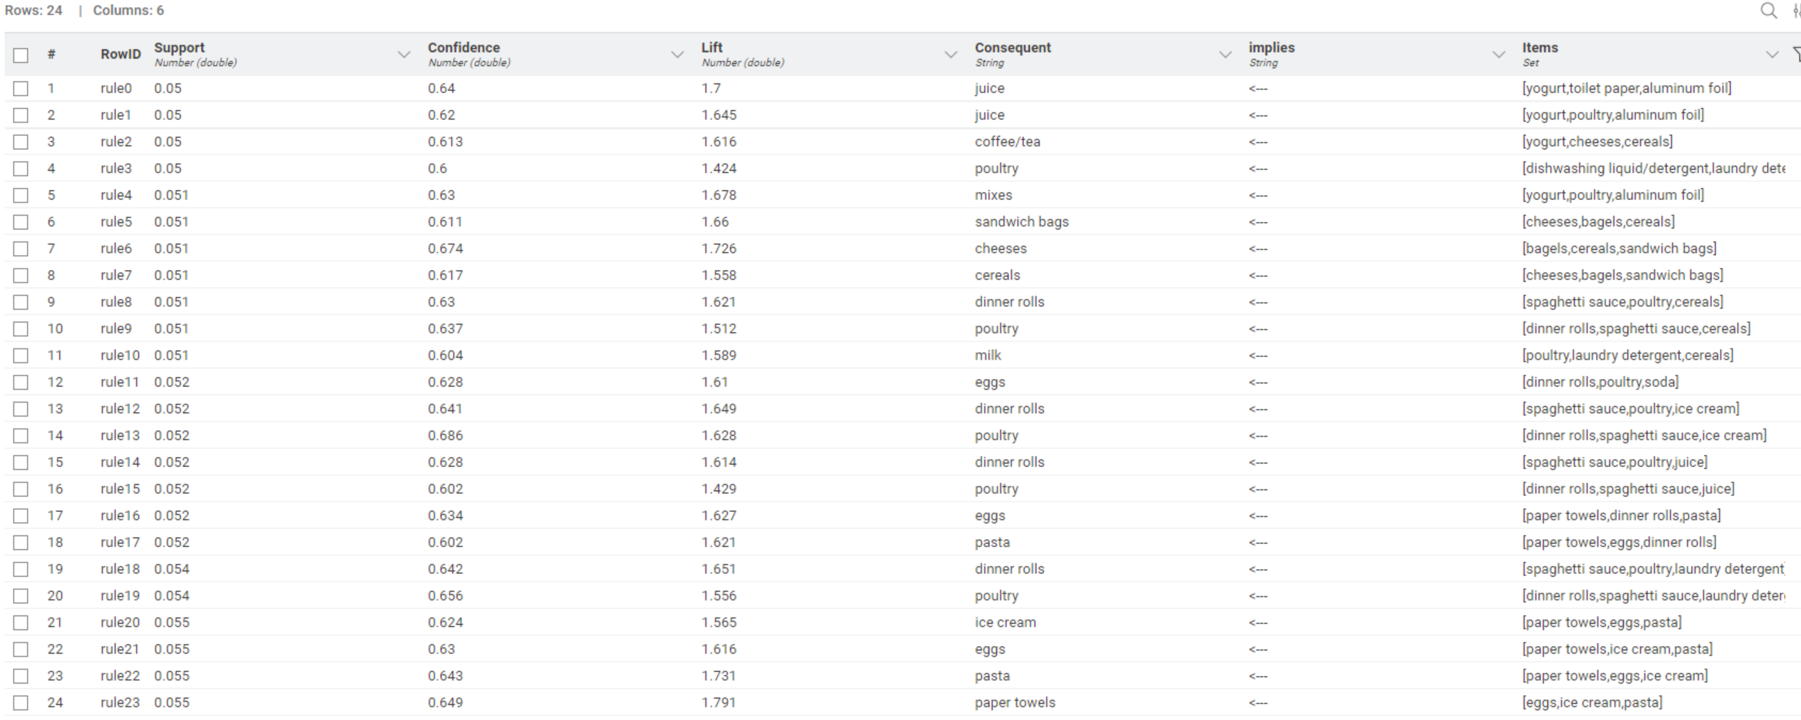
MARKET BASKET ANALYSIS (4/5)
Market Basket Analysis Output Table from KNIME Workflow
How to interpret/read an association? (For instance, lets interpret Rule 0 with Consequent juice, and, Antecedents yogurt, toilet paper, aluminium foil):-
Support of 0.05 signifies the itemset (yogurt, toilet paper, aluminium foil) has appeared in 5% of all transactions.
Confidence of 0.64 signifies that 64% of the time, when the antecedent items (yogurt, toilet paper, aluminum foil) are bought, the consequent item (juice) is also bought.
Lift of 1.7 means that items are bought together [yogurt, toilet paper, aluminum foil & juice] 1.7 times more frequently than would be expected if the item was purchased independently [juice]

Slide 46

MARKET BASKET ANALYSIS (5/5)
Key Insights from the Analysis from Market Basket Analysis Output Table
Popular Core Items:
Poultry, Dinner Rolls, Eggs, Juice, Ice Cream, and Pasta appear frequently in both antecedents and consequents, indicating they are core products in shopping baskets.
Strong Product Associations:
Spaghetti Sauce + Poultry → Juice (high confidence and lift)
Paper Towels + Eggs → Ice Cream, also appears repeatedly.
These indicate reliable product pairings in consumer behavior.
Repeated Antecedent Patterns:
Itemsets like Yogurt, Poultry, Aluminum Foil occur multiple times with different consequents – suggesting strong bundle potential.
Lift Values > 1.6 in Many Rules:
Lift values above 1 suggest that the presence of the antecedent strongly increases the chance of the consequent being bought—ideal for cross-selling.

Slide 47

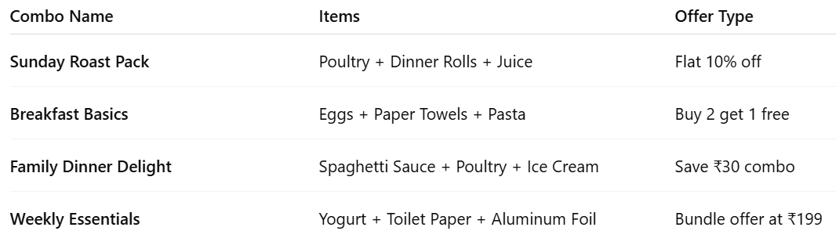
INFERENCES & BUSINESS RECOMMENDATIONS (1/3)
Business Recommendations
1
Combo Bundles with Discounts
Create curated combo packs based on highly associated items.

Slide 48

INFERENCES & BUSINESS RECOMMENDATIONS (2/3)
Business Recommendations
2
Cross-Sell Strategies
In-Store / App Recommendations:
If a customer adds Poultry → suggest Juice or Dinner Rolls.
If cart has Eggs + Pasta → promote Ice Cream as a sweet ending.
Email / SMS Offers:
“Buying Pasta? Get 20% off on Eggs when you add both!”
3
Store Layout Optimization
Place frequently co-purchased items in close proximity:
Pasta → Eggs → Paper Towels
Poultry → Dinner Rolls → Juice
For online apps: Show “Frequently Bought Together” banners using these combinations

Slide 49


INFERENCES & BUSINESS RECOMMENDATIONS (3/3)
Business Recommendations
4
Loyalty and Seasonal Promotions
Festival / Holiday Kits:
Use high-confidence associations for curated holiday kits.
Loyalty Points:
Extra points on combos that include 2 or more associated items.
5
Stocking and Inventory Planning
Use rule strength (support, confidence) to stock Poultry, Eggs, Juice, etc., in proportion to associated items.
Ensure associated items are not out-of-stock together to prevent lost sales opportunities.

Slide 50


